Slide 1

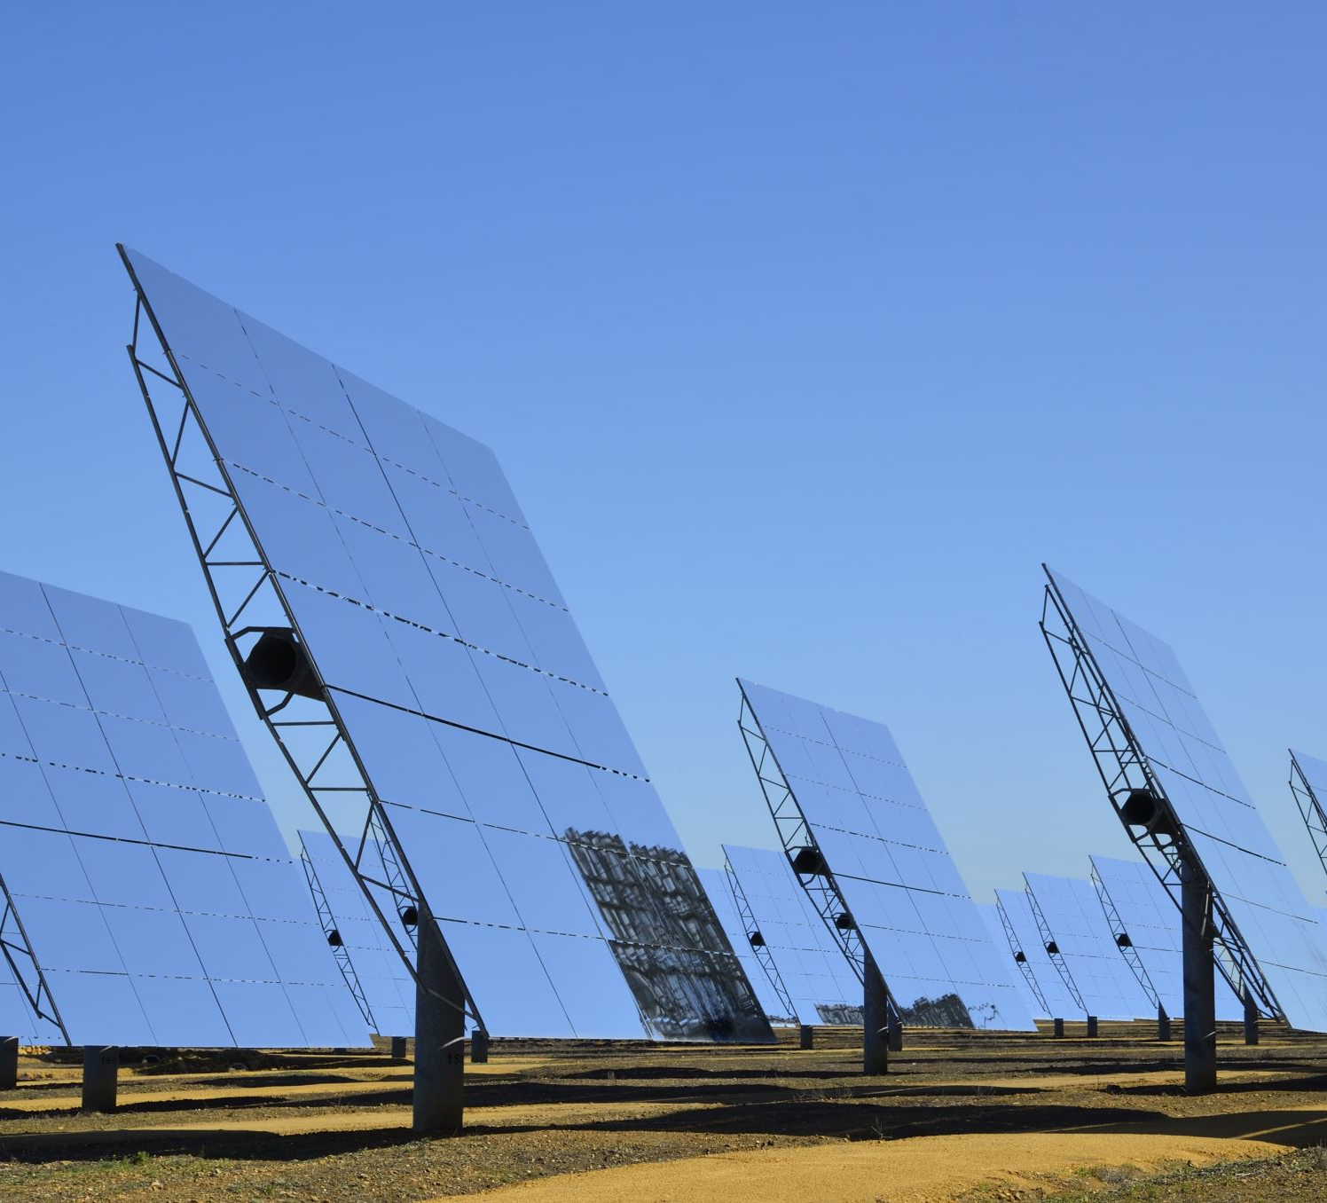
Executive Summary
Project: Sunridge Solar (25 MWdc / 20 MWac)
Location: La Paz County, Arizona
Sponsor: SierraWave Energy Holdings (NYSE: SWEH)
Structure: Non-recourse project finance (SPV)
COD: 1 Jan 2028; PPA: 20-year fixed price
Key Metrics:
- Levered IRR: 7.51%
- Equity Multiple: 2.0x
- Year-1 CAFD: $737,156
- P50 DSCR: 1.35x
- P99 DSCR: 1.00x

Slide 2

Project Overview & Status
Asset: 25 MWdc / 20 MWac utility-scale PV
Technology: Tier‑1 mono modules, single-axis tracking
Site: 180-acre leased site, La Paz County
Development Status:
- Land lease executed
- Interconnection SIS complete
- Environmental studies complete
- PPA in advanced negotiation
- EPC RFP underway
Timeline:
NTP: Mid-2027 | COD: 1 Jan 2028

Slide 3
Capital Structure & Financing Plan
Total Project Cost: $30.54m
Debt (DSCR-constrained): $23.67m
Equity Requirement: ~$6.87m
Leverage: ~77% Debt / 23% Equity
Debt Structure:
- Senior secured non-recourse PF loan
- Tenor: 18–22 years
- DSCR thresholds: P50 ≥1.35x; P99 ≥1.00x
- Interest rate (model): 4.65% all-in
- DSRA: 6 months

Slide 4
Financial Summary (Model Outputs)
Energy Production:
- P50 Yr‑1: 50,370 MWh
- Degradation: 0.50%/yr
Cash Flows:
- Yr‑1 CAFD: $737,156
- PPA CAFD (Years 1–20): ~$12.4m
- Merchant tail CAFD: ~$1.3m
Returns:
- Levered IRR: 7.51%
- Equity Multiple: 2.0x
- Payback: 9.9 years

Slide 5
Key Risks & Mitigants
Construction Risk: Fixed-price EPC, LDs, contingency
Resource Risk: IE-validated data, P50/P90/P99 cases
Offtaker Risk: IG-rated utility, fixed tariff
Financing Risk: DSCR-based sizing, swap hedge
Merchant Tail Risk: Conservative $35/MWh assumption
Regulatory Risk: Permits in advanced stages

Slide 6
Strategic Fit & IC Recommendation
Strategic Fit:
- Expands SierraWave’s contracted portfolio
- Strengthens CAFD visibility
- Fully non-recourse — no corporate leverage impact
- ESG-aligned asset in high-quality solar region
Recommendation:
Proceed to finalize PPA, EPC, and financing.
Advance Sunridge to Financial Close in 2027.

